Slide 1

WELCOME COHORT TWO!
  Facilitators: Joy Walton, MD, MPH, Associate Program Director, Internal Medicine Residency and Medical Director Community Care, OhioHealth Doctors Hospital and
  JP Orlando, EdD, J.P. Orlando, EdD, MSEd, PCC, Adjunct Associate Professor of Education Division of Teaching, Learning, and Leadership Graduate School of Education, University of Pennsylvania
  National Advisory Council: John Andrews, MD, Group Vice President, Medical Education, American Medical Association
Henry Ford Rochester Hospital
OhioHealth (Community Care)
Hackensack Meridian
AdventHealth Orlando
Aurora Health Care (Air Quality)
TriHealth
Baptist Health
NI X Meeting Three Storyboard Presentations

Slide 2

11:35 – 1:45 pm: Storyboard Presentations
Welcome & Introductions
  Facilitators: Joy Walton, MD, MPH, Associate Program Director, Internal Medicine Residency and Medical Director Community Care, OhioHealth Doctors Hospital
  JP Orlando, EdD, J.P. Orlando, EdD, MSEd, PCC, Adjunct Associate Professor of Education Division of Teaching, Learning, and Leadership Graduate School of Education, University of Pennsylvania
  National Advisory Council: John Andrews, MD, Group Vice President, Medical Education, American Medical Association
Assign a Timekeeper
8-10 Minute Storyboard Presentations
Purpose: Share & Learn = Please provide feedback & join in discussion after each presentation
1:35 – 1:45: Overall Reflections from Facilitator & National Advisory Council
1:00 – 1:10 pm: Suggested Break time
(Facilitators and team to determine when/if a short break is needed)
Notes:
Read the slide which describes today’s objectives Be sure to note there are two options for time keeping:
If you take the 10-minute break:
7 projects @120 minutes = 12-minute presentations & 5 minutes for group feedback
If you do not take the 10-minute break:
7 projects @ 130 minutes = 13-minute presentations & 5 minutes for group feedback

Slide 3
Henry Ford Rochester Hospital

Slide 4




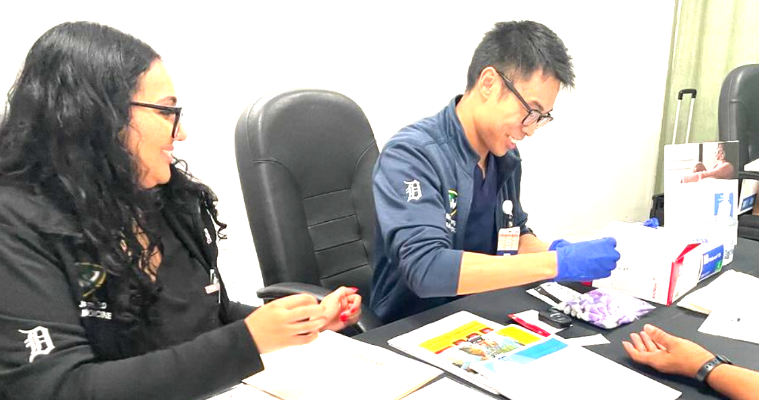
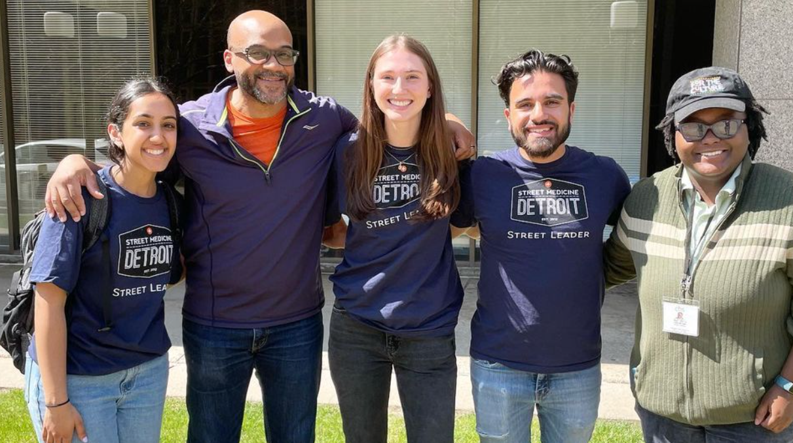
Enhancing Residents’ Professional Identity Formation & Fostering Faculty Learning Plans in the
FM Residency Program at Henry Ford Rochester Hospital (HFRH), MI
Eleanor King, MD, Director, FM Residency Program; Andrea Milne, MD, PhD, Assoc. Program Director, FM Residency Program; Heidi Kenaga, PhD, GME Research Coordinator, WSUSOM; Sheryl Wissman, MD, Chief Medical Officer, HFRH; Anne Messman, MD, DIO WSUSOM; Mehak Ahmed, PGY-2, FM Residency Program,
Kathryn Cox, MD, FM Residency Program
Introduction/Background
Measures
Outcomes (Faculty)
Our project aims to cultivate a more resilient professional identity among our Family Medicine (FM) residents in today’s demanding healthcare environment, since this impacts patient care and a physician’s well-being, confidence, and efficacy.¹ As in NI IX, FM uses the tools of narrative medicine -- reflective writing genres -- to assess the progression of professional identity formation (PIF) in residents and individualized learning plans (ILP) to foster PIF in faculty. FM seeks a better understanding of our residents and faculty as well as those features of the clinical learning environment that promote their transformation into healers of the first rank.
Residents: N = 39. FM uses multiple data sources to illuminate how residents’ training encounters help form their identity as physicians: Reflections, GME surveys, and end-of-year program surveys. Residents have protected time during lectures to compose responses to two prompts: “What made you feel like a doctor this week?” and “What challenged you or what did you struggle with?” During the 2025-26 AY, FM collected 35 reflections, subdivided by year: PGY-1s = 13, PGY-2 = 12, and PGY-3 = 10.
Faculty: N = 5. The measure of progress is self-reported data in response to the prompt “If a resident asked you about this skill, would you feel confident enough teaching them?”
ILP GOALS - FM FACULTY | FALL 2026 MILESTONES
Developing point-of-care ultrasound (POCUS) skills | Two faculty trainers scheduled for 1 year of resident sessions, including a Sim Lab
Expertise in hormone replacement therapy (female patients) | Completed AAFP Menopause course, started second from Menopause Society. Test scheduled June 2027
Expertise in hormone replacement therapy (male patients) | Completed CME on testosterone HRT. Pending course on erectile dysfunction and other male urologic conditions
Specialization in obesity medicine | CME complete. Test scheduled October 2027
Expanding community outreach | Established monthly satellite clinic at homeless shelter
Objectives/Alignment
Fostering a sense of professional mission and stewardship of the discipline in trainees is a priority of the FM program, HFRH, and WSUGME. The establishment of a community service/outreach curriculum in 2024-25 (ICARE)² was a first step toward achieving this goal. FM believes that providing
residents the time and space to reflect and
faculty the autonomy and support to pursue their individual interests will enhance the development of our physicians’ professional identity
Barriers & Strategies
Maintaining resident interest in writing
Keeping focus on writing reflections rather than venting
Addressing faculty time limitations
Securing funding for training (e.g., CME courses, Sim Lab)
Combating inertia in faculty professional development trajectory
Preliminary Outcomes (Residents)
What made me feel like a doctor this week was helping a patient obtain a hospital bed for her home...This experience made me feel like a doctor because it reflected the broader purpose of the profession: seeing patients as whole people and not just as a collection of medical problems. The hospital bed wasn’t just equipment; it was a way of supporting her health.
Interventions
Discussion
FM continues to analyze resident reflections to isolate themes related to professional identity formation and tracks faculty progress in meeting individualized goals, anticipating that each will have made significant progress toward their goal by the conclusion of NI X in spring 2027.
Analyzing resident reflections about patient encounters and training experiences to gauge development of a compassionate professional identity
During the past month, I feel as though I have seen a lot more complex patients in the clinic, leading to a lot more work outside of the usual office hours...This started to lead to it being difficult to turn off of “work mode” and...led to worries about balancing work and life when I am out in practice.
Instituting ILPs for faculty centering on procedures required by ABFM. Faculty provide accountability for development of their professional identity as healthcare providers and educators
References
As a new resident, imposter syndrome can still linger — the shift from student to physician is a significant one. For so long, you’re in a learning role, watching others lead care. Then suddenly, you’re the one making decisions...I felt that doubt begin to lift. A few patients expressed heartfelt gratitude — not just for their medical care, but for the time I took to listen, explain, and offer reassurance.
1. Silver M, Hussain F. A resident narrative medicine curriculum to promote professional identity development. MedEdPORTAL 2024 Oct 22;20:11446. doi:10.15766/mep_2374-8265.11446.
2. King E, Kenaga H, et al. Implementing a community outreach curriculum in a primary care residency: The creation of ICARE (Integrating Community Agencies in Residency Education) by the WSU School of Medicine’s Family Medicine Program. MI Med Educ Health Bull 2026 May 11;4(1):29-34. doi.org/10.69735/001c.1617
AIAMC NI X Meeting 3 - 10/9/2026

Slide 5
OhioHealth
(Community Care)

Slide 6

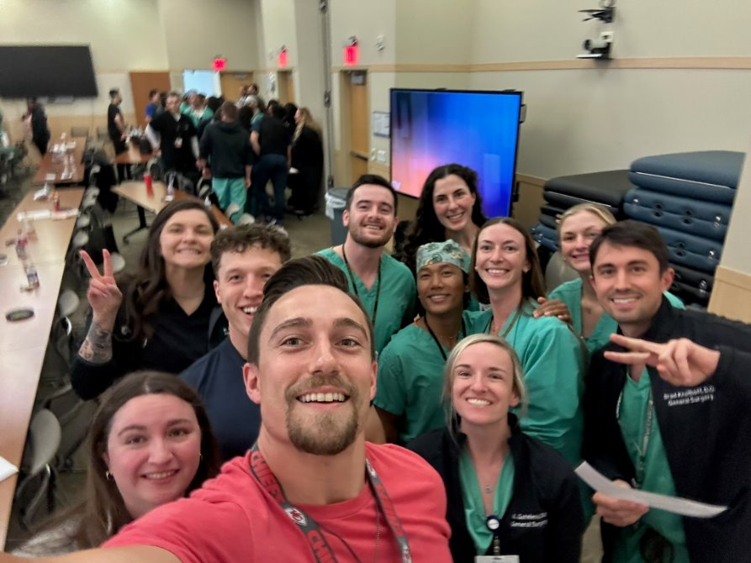
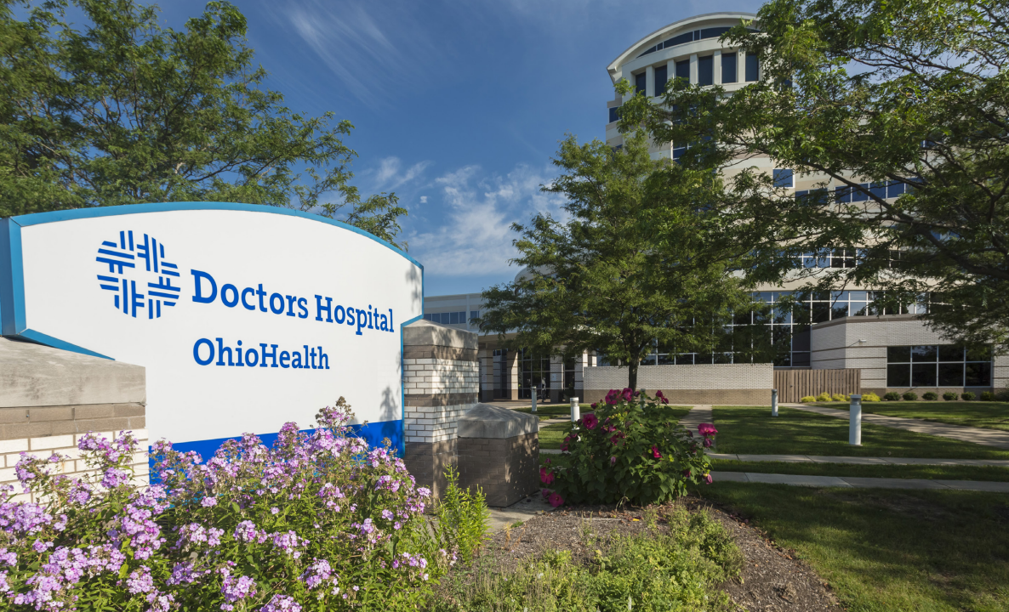
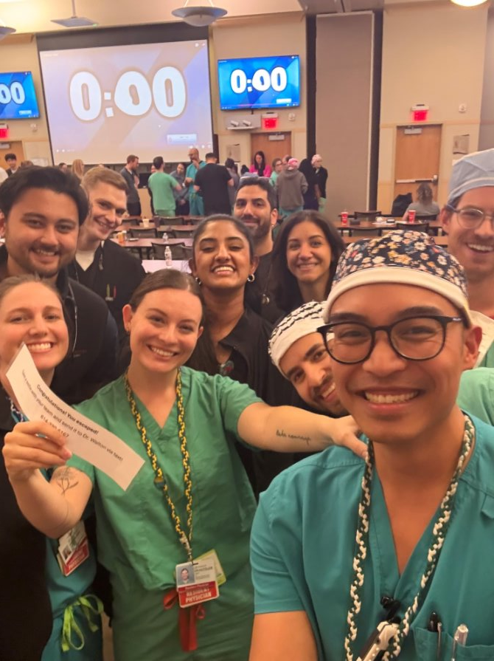

Heart of a Healer: Developing Professional Identity
Through the Care of Communities Experiencing Vulnerability
Joy Walton MD | Alexandra McKenna DO | Melissa Rudie DO | Jaynine Vado DO | Molly Wilson MD | Liz Zmuda DO
Ashley Gerard DO | Lindsay Merrin DO | Rebecca Rupff DO | Maura Donnelly OMS-III | Sarah Fagbamigbe DO | Meg Conover MSc | Hailey Kurtz OMS-II
OhioHealth Doctors Hospital Community Care
Introduction: Background & Context
Interprofessional education experiences (IPE)
Interdisciplinary Conferences (IDC) and Community Care at Doctors Hospital
Formally analyze resident feedback and explore how IPE experiences with underserved populations influence professional identity

Slide 7
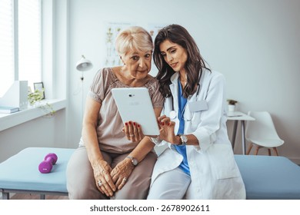
Aim/Objectives/Alignment
We are continuing our efforts to determine the impact organized didactics and clinical experience have on the development of professional identity for our residents. We are increasing their exposure to interdisciplinary collaboration, health equity, and service to underserved populations, with a goal of determining how these experiences contribute to their development of professional values and identity as physicians with the heart of a healer

Slide 8
Project planning & survey development
Launch IDC series AY 25/26
Launch resident surveys
Mid-point data review
Launch IDC series AY 26/27
Measures
Baseline survey collection, finalizing IDC curriculum & curriculum & survey questions
IDC 9/19/25 “You vs. Doctor You: Reconciling who you are with the physician you are becoming”
IDC 12/12/25 “Level Up Your Communication: skills for effective interdisciplinary teamwork”
IDC 3/6/26 "Building Fortitude in Residency"
IDC 5/1/26 "Legal and Financial Wellness"
IDC 10/14/26 "You vs. Doctor You 2.0: Navigating the Clinical Ecosystem"

Slide 9
Interventions/Changes
Quantitative analysis of IDC survey data with percent change in Likert score
Qualitative analysis of narrative surveys of Community Care experiences
Cumulative Impact on Professional Identity Formation

Slide 10

Barriers & Strategies
Low survey response rate
  Poor uptake despite QR codes, dedicated didactic times, direct ask while on-site
  Low interest from PDs
  Variance in program expectations around attendance
Operational changes in Community Care
  Separation of IM/FM collaboration due to operational streamlining of cost center
Transition of Director of Medical Education
  Lack of clarity around future existence of IDC and support

Slide 11
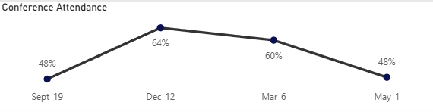
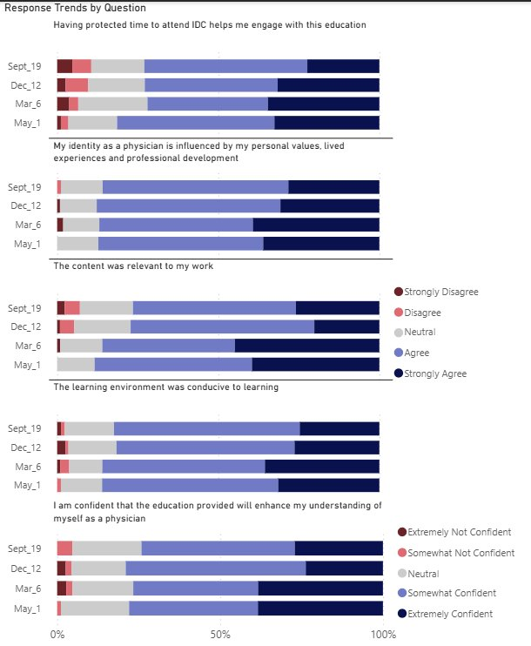
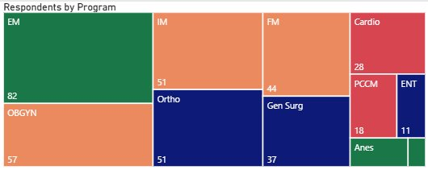
Results
Who Attended IDC?
How did they respond?
55% of all residents and fellows at Doctors Hospital attended at least one IDC conference
"It has truly shown me how many people are in need. On top of that it has taught me to be flexible in order to adapt to the various needs of my patients in SDOH"
"I initially wanted to work in an area that had a lot of SDOH, but I am finding that I am tired from having so many encounters with so many barriers."
"I enjoy providing health education to patients with lower health literacy"
Experience that made a meaningful impact: "Plenty of instances especially from a medication standpoint where I have had to find alternative ways for the patient to get the medication that they need"

Slide 12
Discussion
Key takeaways: IDC and Community Care experiences may support physician identity formation
Quantitative IPE survey findings: Communication and collaboration were the most frequently reported skills gained
Qualitative Community Care survey data: 8 FM/IM residents responded to date; responses suggest that experiences in Community Care may foster a commitment to equitable, compassionate care
Next steps: Analyze the October 14, 2026 IDC: “You vs. Doctor You 2.0” focused on imposter syndrome and navigating the clinical environment. Relaunch/rebrand Community Care surveys
Challenges: Limited qualitative responses and uncertainty regarding continuation of future IDC sessions.

Slide 13
Hackensack Meridian

Slide 14

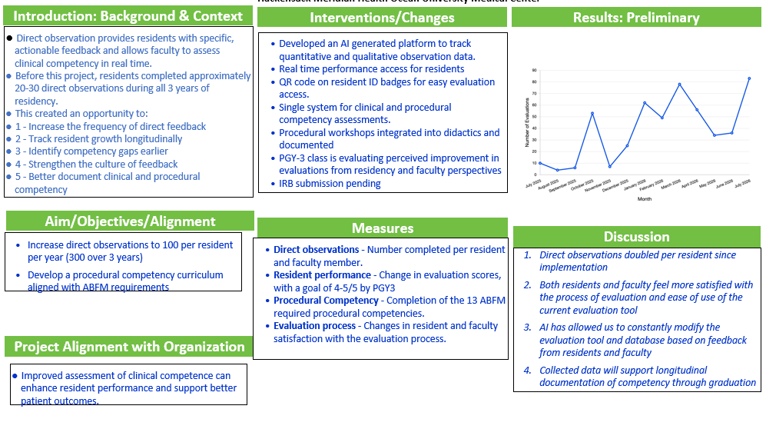
Improving Clinical Competency Through Direct Observation in
Family Medicine Residency
Yousef Ksheboon MD¹, Christina Delisi MD¹, Sagar Acharya MD¹, Apurva Patil MD¹, Ann Yacoubian MD¹, Shana John MD¹, Andrez Paz DO¹, Akshay Patel MD¹, Jillian Weinfeld MD¹, Kelly Ussery- Kronhaus MD¹, Kenneth Kronhaus MD¹
¹Hackensack Meridian Health Ocean University Medical Center

Slide 15
AdventHealth Orlando

Slide 16

AdventHealth Orlando: Enhancing the Clinical Learning Environment Through Fostering Optimal Communication Practices and Optimizing Psychological Safety
Alexandra Lajeunesse MA, Tyon Hall PhD, Shani Cunningham DO, Dwayne Gordon MD, Amanda Bailey MA, Natsha Bradley MA, Megan Dowdell MA
Introduction: Background & Context
Psychological safety is essential for effective learning, communication, and collaboration within clinical teams. Research has demonstrated that increased interprofessional familiarity and effective communication improve team performance and psychological safety, while supportive team dynamics foster open dialogue, role clarity, and continuous learning.
This quality improvement initiative implemented a structured observation and feedback process in which a trained therapist assessed team interactions and provided feedback to faculty and residents with the goal of enhancing communication practices and strengthening psychological safety within the clinical learning environment.

Slide 17
Aim/Objectives/Alignment
Aim
To improve psychological safety and communication within the clinical learning environment by implementing a therapist-led observation and feedback program for faculty and residents, with effectiveness measured through changes in TOSCE communication ratings, Edmondson Psychological Safety Index scores, and ACGME Well-Being Survey results over the project period.
Objectives
Conduct structured observations of faculty and resident interactions using validated team communication and collaboration assessment tools.
Provide inclusive, equitable, and actionable feedback to participating faculty and residents through group education sessions and individual feedback meetings.
Identify communication behaviors that support or hinder psychological safety and team effectiveness.
Measure pre- and post-intervention changes in psychological safety, communication, teamwork, and resident well-being using validated assessment instruments.
Use findings to inform ongoing improvements to the clinical learning environment and faculty development initiatives.
Alignment
This project supports organizational priorities related to patient safety, team effectiveness, physician well-being, resident education, and continuous quality improvement. It aligns with ACGME expectations for a psychologically safe learning environment by promoting effective communication, feedback, collaboration, and professional development. The project demonstrates the value of the GME Wellbeing Program by providing a structured, evidence-based approach to improving the clinical learning environment, strengthening faculty and resident relationships, supporting trainee well-being, and fostering a culture of continuous learning and psychological safety.

Slide 18
Measures
Achievement of the aim will be demonstrated by improvements in communication, collaboration, psychological safety, and resident well-being following implementation of the therapist-led observation and feedback intervention. Success will be reflected through positive changes in pre- and post-intervention assessment scores and participant feedback.
Measures/Metrics/Data Sources
TOSCE (Team Observed Structured Clinical Encounter): Assessment of communication, collaboration, roles and responsibilities, conflict management, patient-centered care, and overall team functioning.
Edmondson Psychological Safety Index (PSI): Pre- and post-intervention measurement of psychological safety, including comfort speaking up, willingness to seek help, openness in communication, and perceptions of inclusion.
ACGME Well-Being Survey: Assessment of resident well-being and perceptions of the learning environment.
Faculty and Resident Feedback: Qualitative feedback collected during individual feedback sessions and group debriefs to identify themes, strengths, and opportunities for improvement.
Participation Metrics: Attendance and engagement in workshops, feedback sessions, and project activities

Slide 19
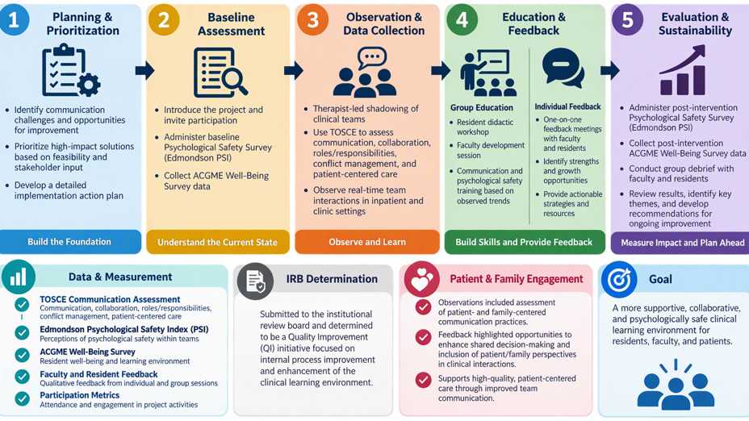
Interventions/Changes

Slide 20
Barriers & Strategies
Scheduling and Participant Availability
The primary challenge was coordinating observation sessions across faculty and resident schedules. Residents rotate through different services, locations, and shift schedules, making it difficult to observe all participants within the project timeline. Faculty clinical responsibilities and competing educational commitments further limited available observation opportunities.
Additional Challenges
Variability in resident rotations and clinical assignments
Multiple clinical settings and team structures
Achieving representative observations across all participants
Mitigation Strategies
Flexible observation scheduling
Collaboration with program leadership, administration and chief residents
Multiple observation opportunities across settings
Ongoing communication and schedule tracking
Key Lesson Learned: Early planning, scheduling flexibility, and strong stakeholder engagement are essential for successful implementation of observation-based quality improvement initiatives.

Slide 21
Results
Project Progress to Date:
Internal Medicine-
Initial Psychological Safety Assessment completed
Observations have been completed for Internal medicine.
Faculty have received their group feedback.
Residents scheduled to receive group feedback end of October
Individual feedback sessions will begin for both faculty and residents in November.
Data measures of any changes will be available after March.
Pediatrics-
Project introduction completed for both faculty and residents
Initial Psychological Safety Assessments being sent this week.
Pediatrics begins 5 months of observations this week.
Feedback will be provided in March.
Data measures of any changes will be available after March.

Slide 22
Discussion
What strategies can improve participation and scheduling feasibility?
What additional outcomes should be measured to demonstrate organizational impact?
How can psychological safety initiatives be embedded into ongoing faculty and resident development?
Citations/References
Riskin, A., et al. (2019). Effect of increased interprofessional familiarity on team performance, communication, and psychological safety on inpatient medical teams: A randomized clinical trial. JAMA Internal Medicine, 179(8), 1018-1024.
Sujan, M., Huang, H., & Braithwaite, J. (2023). Systematic review of factors that enable psychological safety in healthcare teams. International Journal for Quality in Health Care, 35(2), mzad032.
Edmondson, A. C. (1999). Psychological safety and learning behavior in work teams. Administrative Science Quarterly, 44(2), 350-383.
Accreditation Council for Graduate Medical Education. (2025). ACGME Resident/Fellow Survey Program Resources.

Slide 23
Aurora Health Care
(Air Quality- Escape Room)

Slide 24



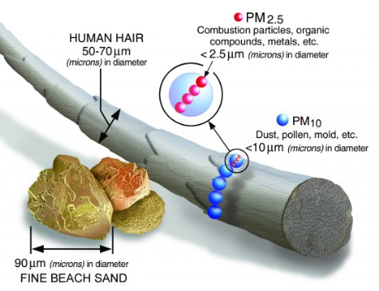

Introduction: Background & Context
Creation of air quality escape room
Internal Medicine
Victoria Gillet, MD; Matt Zabel, DO; Delaney Cairns, MD
Air quality affects many as this environmental hazard is not easily contained (e.g. Canadian forest fire smoke crossing borders)
There are significant environmental exposures:
  Proximity to factories, highways, power plants
  Occupations in factories and foundries
  Exposures at home like tobacco smoke and gas stoves
Graphic: Particulate Matter (PM) Basics | US EPA
Particulate matter < 2.5 micrometers in diameter crosses the lung barrier into blood, causing systemic host inflammation
Volatile gasses like ozone, carbon monoxide, sulfur dioxide cause oxidative stress and inflammation

Slide 25
Aim/Objectives/Alignment
Identify air pollutants that are of major health concern
  Ozone, particulate matter, sulfur dioxide, nitrogen dioxide, carbon monoxide
Recognize risk factors that increase exposure to air pollutants and intentionally screen for them in a patient encounter
  Occupational exposures
  Local environmental exposures (i.e. proximity to highway, local power plants)
  Indoor sources (gas stoves, fireplace, tobacco)
Identify health consequences of exposure to air pollutants
  Asthma/COPD
  Stroke
  Heart Attack
Recommend both short-term (e.g. box fan filters) and long-term interventions (e.g. housing referrals) to decrease risk
  Recommend at-risk patients check AQI same way the check weather
  Minimize indoor sources of pollution
  Use N95/KN95
  Filters (air purifier, DIY fan filter)
  Minimize outdoor exposure

Slide 26
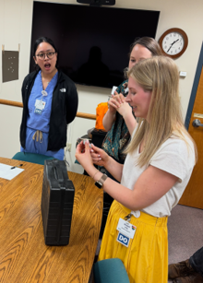
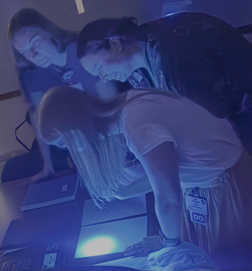
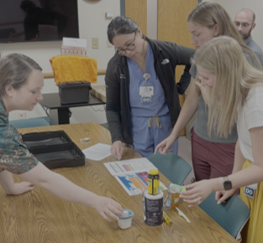
Examples of puzzles in escape room

Slide 27
Measures
Divided into 2 aims: 1) learning about air quality and 2) translating knowledge into information for patients (e.g. counseling, AVS)
Pre/post survey questions on a scale of 1-10: Rate your
  Knowledge about Air Quality
  Environmental, occupational, and indoor/personal risk factors that contribute to poor air quality
  Health consequences that poor air quality can have on patients’ chronic health conditions.
  Information for Patients
  How confident you are in prescribing preventative measures for high-risk patients regarding poor air quality and their chronic medical concerns
  Your knowledge of resources that can be provided to patients to help them evaluate air quality and understand their risks.
  Your knowledge of volatile gases and particulate matter that can contribute to poor air quality.
How would you describe your overall knowledge of air quality, the effect it can have on chronic medical conditions, and preventative measures you can take to protect your patients?
  Low, Basic, Intermediate, Advanced

Slide 28
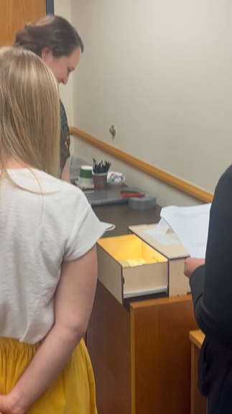
Interventions | Changes
Participants identified the patient's chronic medical conditions which were affected by poor air quality
  COPD
  CKD IIIa
  Heart failure with reduced EF
  Cirrhosis
  SLE/lupus
  Type 2 diabetes
  Participants filled out an AVS with multiple recommendations gleaned from the escape room
  Mask like N95
  Check AQI
  Build a filter + fan unit

Slide 29
Barriers Strategies
Environmental risk factors
Occupational risk factors
Indoor pollutant risk factors
Particulate matter size
Find a flashlight which illuminates "hot spots" on city map
Find a job application for a position with exposures to: diesel exhaust, combustion products (manufacturing), CO (garages or warehouses), silica dust, asbestos, heavy metals (lead), solvents (manufacturing)
Find a shopping list with items that pollute in:
    Cigarettes (cigarette smoke)
    Firewood (wood burning fumes)
    Kerosene/propane (gas burning stoves or items)
    New carbon monoxide detector (carbon monoxide)
    Cleaning supplies (bleach, ammonia containing products, disinfectants)
    Fans (for mold management)
    Candles/oil infusers
    Dog food (pets/dander)
    Paint (lead based)
Each step above will yield participants a number, which yields "2.5" to represent the particulate matter size which can infiltrate the blood

Slide 30
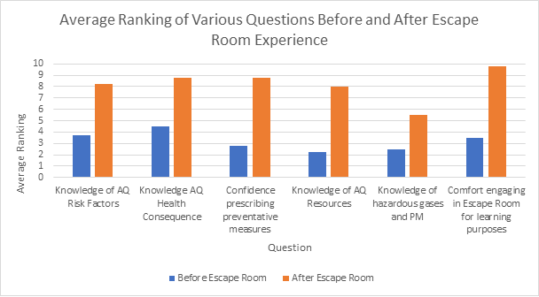
Results

Slide 31
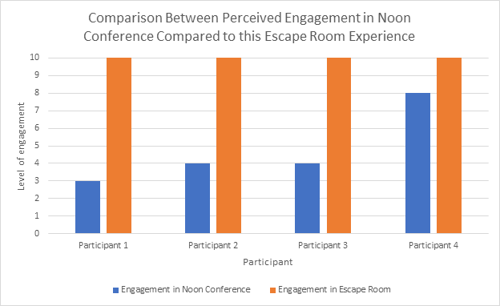
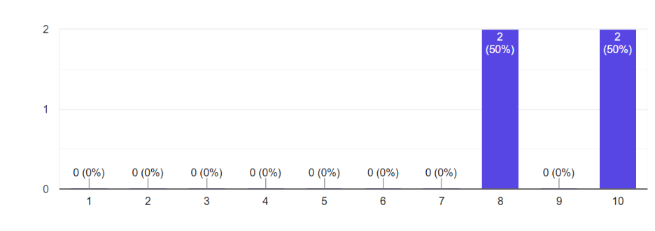
Results
On a scale of 1-10, how helpful did you find the debriefing sessions regarding knowledge refinement and overall education on the health risks of air quality (1 – not helpful, 10 – quite helpful)?

Slide 32

Discussion
Next Steps
Did test run of escape room with small group of residents
Will implement changes including a post-escape room didactic on pathophysiological mechanisms of air pollution
Will add intentional debriefing prior to large-group implementation
Areas Seeking Guidance
Other activities to do while small-groups funnel through the escape room

Slide 33
TriHealth

Slide 34

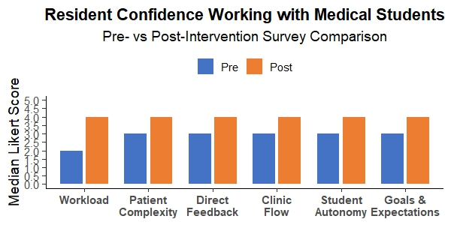

Developing a Collaborative Learning Model maximizing Student and Resident Experience
Elizabeth Beiter, MD; Matthew Orischak, MD; Alexis Williams, DO, Jackline Kiprono, MS, Becky Fleig, MEd
Introduction: Background & Context
Interventions/Changes
Results: Preliminary
Xavier University is starting a new osteopathic medical school and TriHealth is the primary health care partner. Additionally, TriHealth is adding three new residency programs. Across all our GME programs one of the consistent areas of focus on the ACGME survey is the impact of other learners on resident experience. There is currently no formal “residents as teachers” learning curriculum. Additionally, osteopathic residents are consistently represented in all our GME programs however there is no formal osteopathic continuing education during residency training at TriHealth.
Survey Residents and medical students on drivers of poor satisfaction and apply PDSA methodology to the problem areas identified in the survey.
Provide education on teaching strategies
Optimize point of care feedback tool for evaluation of medical students
Create and implement medical student expectation document.
Roll out DAX AI to reduce documentation burden and improve time management
Development of longitudinal OMM curriculum for residents with Xavier University
Likert- scale responses were summarized as median (IQR) and compared between pre and post using Wilcoxon rank sum test
Resident confidence scores increased following implementation of the intervention
Significant scores were observed in matching patient complexity (P=0.027) and incorporating students without significantly increasing workload (p=0.013)
Results: Preliminary
Aim/Objectives/Alignment
Measures
Examine the key drivers contributing to poor resident experiences with other learners in clinical learning environment.
Pilot targeted interventions to address the most frequent cited factors impacting resident satisfaction
Partner with Xavier University to build a collaborative Osteopathic Manipulation(OMM) experience for osteopathic residents.
Resident pre and post intervention survey data on the dissatisfiers with other learners in the clinical learning environment.
ACGME survey data trends in the questions pertaining to the impact of other learners in the clinical learning environment
Resident satisfaction with new longitudinal OMM curriculum for residents with Xavier University.
Discussion & Next Steps
Residents' confidence improved following implementation of the collaborative learning model.
Standardized expectations and feedback process may support more effective resident student collaboration
Future efforts will focus on broader implementation and continued evaluation.
Next steps:
Lectures for residents educating on adult learning theory and students teaching skills.
Continued quality improvement for QR code use and adherence
Creating overview of medical student expectation.
Repeat resident survey regarding attitudes on clinic.
Project Alignment with Organization
OMM faculty for medical school not yet hired
  Ongoing discussion with Xavier
Variability of medical student performance
  Map cumulative feedback from POC feedback tool to medical student expectations
Delays in DAX roll out
As the primary Health Care partner for the Xavier University Osteopathic Medical school, TriHealth is committed to creating an exceptional and effective clinical learning environment.
This project aligns with the partnership in enhancing satisfaction, teaching quality, and overall experience for both residents and medical students.

Slide 35
Baptist Health

Slide 36

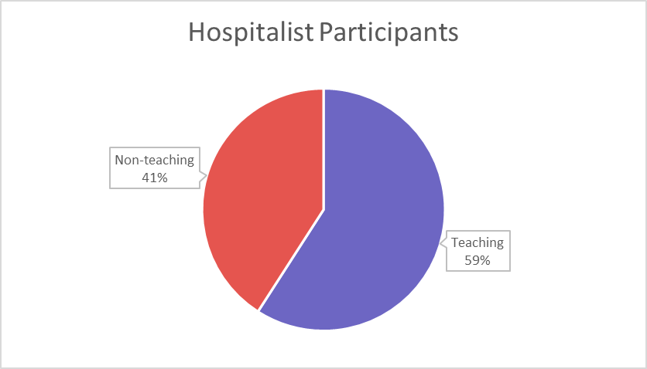
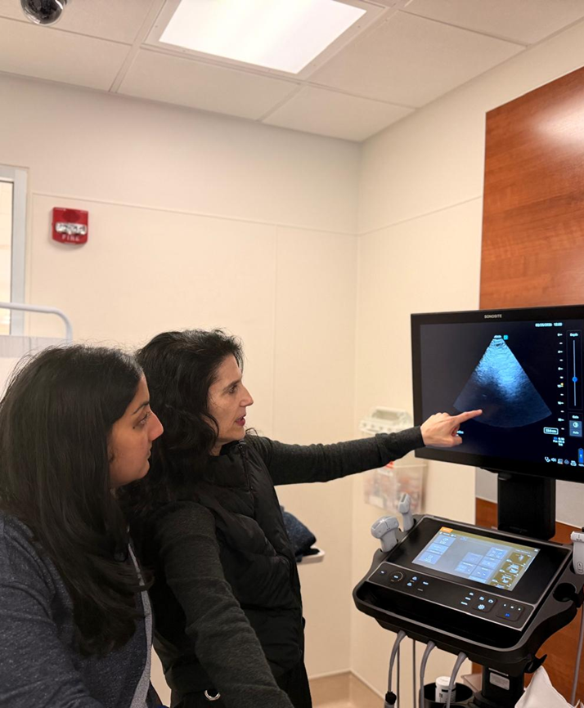
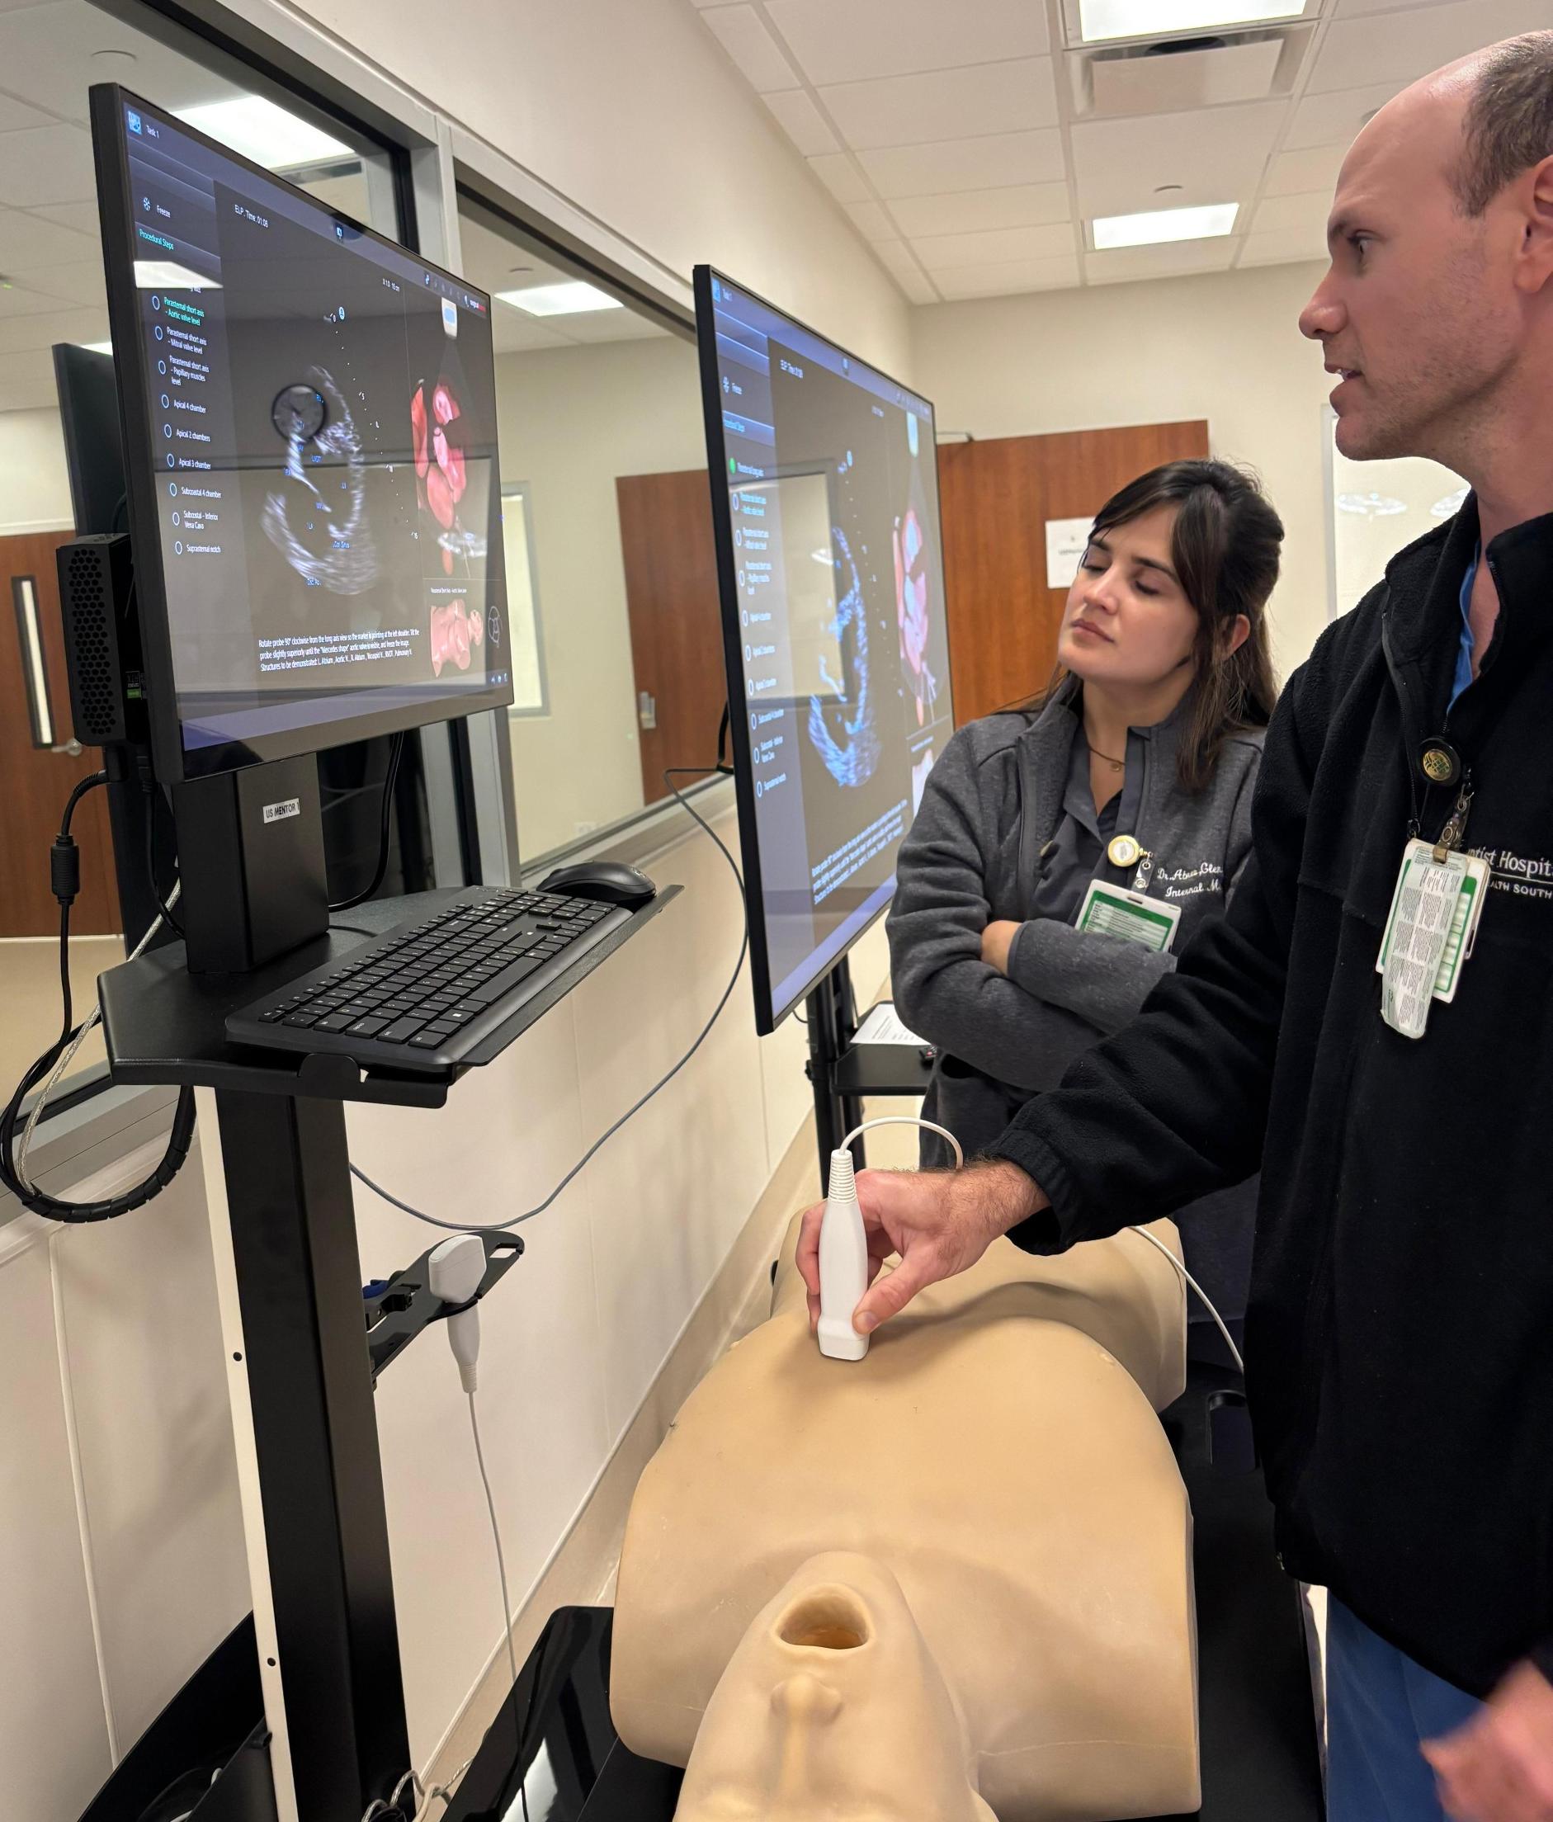
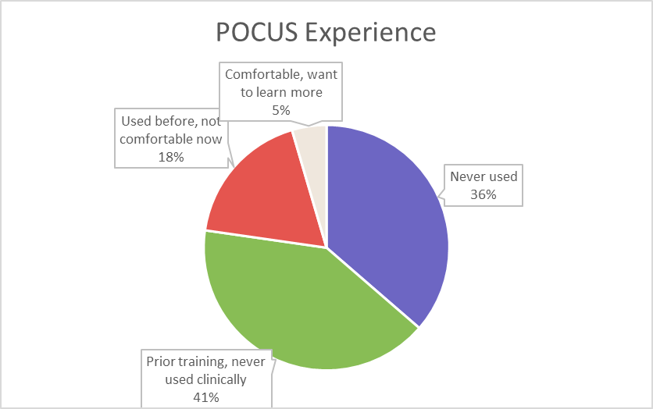
A Focus on POCUS: Faculty Development to Enhance Bedside Ultrasound Teaching and Procedure Training in Internal Medicine
Seema Chandra, MD | Aldo Manresa, DO | Sebastian Suarez Zarate, MD | Justin Ceballos, DO| Simon Astor, DO |
Andres Soto, MD
Introduction: Background & Context
Interventions/Changes
Results: Preliminary
.
Point-of-care ultrasound (POCUS) is increasingly recognized as a valuable bedside diagnostic tool in internal medicine and hospital medicine. When used at the bedside, ultrasound can improve diagnostic accuracy, enhance physical examination, and support clinical decision-making in hospitalized patients.¹ ² Despite growing interest among trainees, adoption of POCUS within hospital medicine remains limited, often due to lack of faculty training, supervision, and confidence in ultrasound use.¹ ³
The FIU/Baptist Internal Medicine Residency welcomed its first class of thirty residents in June 2025. In developing the curriculum, we identified POCUS education as a key component. However, without faculty expertise, POCUS experience is limited for the simulation lab and dedicated practice sessions, and there is no role modeling of its applicability in daily care. While ultrasounds were previously available for hospitalist use, they were rarely used and there was no formal curriculum in place.
This initiative aims to establish a sustainable model for integrating ultrasound into hospital medicine practice and the resident learning environment through a faculty-first training approach with the goal of promoting real-world bedside ultrasound use and enhancing the clinical learning environment for residents..
References:
  Soni NJ, Schnobrich D, Mathews BK, et al. Point-of-Care Ultrasound for Hospitalists: A Position Statement of the Society of Hospital Medicine. Journal of Hospital Medicine. 2019;14:E1–E6.
  Moore CL, Copel JA. Point-of-care ultrasonography. New England Journal of Medicine. 2011;364:749–757.
  LoPresti CM, Schnobrich DJ, Dversdal RK, Schembri F. A Road Map for Point-of-Care Ultrasound Training in Internal Medicine Residency. The Ultrasound Journal. 2019;11:10.
Feb 2026: Twenty-two hospitalists participated in
One-month flipped classroom curriculum
8 hour hands-on workshop (physics, cardiac, lung, inferior vena cava, and bladder ultrasound)
Sept-Oct 2026: 3 hospitalists participated in procedure training (simulation and hands-on) in paracentesis and thoracentesis
Faculty workshop February 2026
Aims/Objectives/Alignment
Measures
Discussion
Aim
Implement and evaluate a longitudinal POCUS curriculum and procedure skills curriculum for faculty hospitalists in a new internal medicine residency
Objectives
Develop educational modules using online videos, question bank, simulation and hands-on training
Expand resident exposure to bedside ultrasound learning
Establish a quality assurance and scan portfolio process aligned with competency recommendations from the Society of Hospital Medicine and the American College of Chest Physicians.
Evaluate outcomes in resident education and patient care
Evaluate faculty satisfaction and use of POCUS
Faculty measures
Number of hospitalists completing the POCUS training curriculum
Adoption of handheld ultrasound use during hospital medicine service
Participation in scan portfolio development and quality assurance review
Credentialing in POCUS and in bedside procedures
Residency measures
Exposure to bedside ultrasound teaching during hospital medicine rotations
Comparison of resident experience when rotating with trained vs non-trained hospitalists
Resident perceptions of bedside teaching and ultrasound integration during rounds
Resident rotations and procedure logs from procedure team rotations
Program measures
Clinical assessment of POCUS utilization
Development of an institutional POCUS quality assurance process
This descriptive education innovation examines the utility of implementing a faculty-first POCUS training program within a new internal medicine residency. Twenty-two hospitalists completed the curriculum and are now participating in a longitudinal quality assurance program. The majority of participants had limited prior ultrasound experience. Only one (5%) reported actively using POCUS before the workshop, highlighting two common barriers: limited faculty training and confidence.
Three faculty have pursued additional training in procedure training as we build our resident procedure team which started in September 2026.
By prioritizing hospitalist faculty skills development, this program expands opportunities for residents to learn ultrasound during routine patient care. Integrating POCUS into bedside rounds allows residents to observe and practice ultrasound in real clinical contexts while supporting clinical decision-making.

Slide 37

Final Thoughts
Facilitator and National Advisory Council
  Joy Walton, MD, MPH, Associate Program Director, Internal Medicine Residency and Medical Director Community Care, OhioHealth Doctors Hospital
  JP Orlando, EdD, J.P. Orlando, EdD, MSEd, PCC, Adjunct Associate Professor of Education Division of Teaching, Learning, and Leadership Graduate School of Education, University of Pennsylvania
  John Andrews, MD, Group Vice President, Medical Education, American Medical Association

